Slide 1
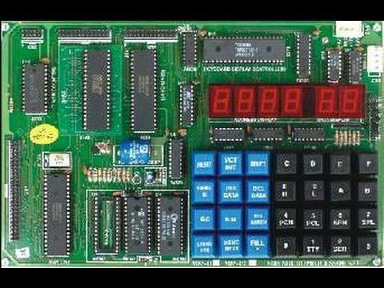
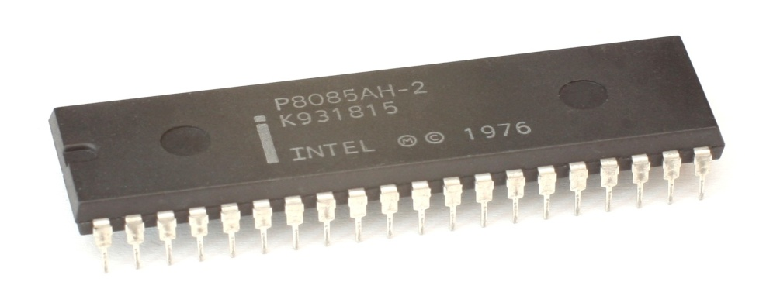
MICROPROCESSOR

Slide 2
Marks Distribution: Total :150 marks
Theory:100 marks
Internal Marks:20 marks
Attendance
Assignment
Class performance
ADT
Final assessment
Final semester exam: 80 marks
Practical: 50 marks
Lab report
Viva
Attendance
Final Practical Exam + MCQ

Slide 3
Syllabus
Microprocessor (Subject Code: EX 551)
Objective:
Familiarizing students with programming, hardware and application of microprocessor.
1) Introduction
1.1 Introduction and History of Microprocessors
1.2 Basic Block Diagram of a Computer
1.3 Organization of Microprocessor Based System
1.4 Bus Organization
1.5 Stored program Concept and Von Neumann Machine
1.6 Processing Cycle of a Stored Program Computer
1.7 Microinstructions and Hardwired/Microprogrammed Control Unit
1.8. Introduction to Register Transfer Language (RTL)

Slide 4
2) Programming with 8085 Microprocessor 2.1 Internal Architecture and Features of 8085 microprocessor 2.2 Instruction Format and Data Format 2.3 Addressing Modes of 8085 2.4 Intel 8085 Instruction Set 2.5 Various Programs in 8085 2.5.1 Simple Programs with Arithmetic and Logical Operations 2.5.2 Conditions and Loops 2.5.3 Array and Table Processing 2.5.4 Decimal BCD Conversion 2.5.5 Multiplication and Division

Slide 5
3) Programming with 8086 Microprocessor 3.1 Internal Architecture and Features of 8086 Microprocessor 3.1.1 BIU and Components 3.1.2 EU and Components 3.1.3 EU and BIU Operations 3.1.4 Segment and Offset Address 3.2 Addressing Modes of 8086 3.3 Assembly Language Programming 3.4 High Level versus Low Level Programming 3.5 Assembly Language Syntax 3.5.1 Comments 3.5.2 Reserved words 3.5.3 Identifiers 3.5.4 Statements 3.5.5 Directives 3.5.6 Operators 3.5.7 Instructions 3.6 EXE and COM programs 3.7 Assembling, Linking and Executing 3.8 One Pass and Two Pass Assemblers 3.9 Keyboard and Video Services 3.10 Various Programs in 8086 3.10.1 Simple Programs for Arithmetic, Logical, String Input /Output 3.10.2 Conditions and Loops 3.10.3 Array and String Processing 3.10.4 Read and Display ASCII and Decimal Numbers 3.10.5 Displaying Numbers in Binary and Hexadecimal Formats

Slide 6
4) Memory Address Decoding with NAND, Block and Microprocessor System 4.1 Pin Configuration of 8085 and 8086 Microprocessors 4.2 Bus Structure 4.2.1 Synchronous Bus 4.2.2 Asynchronous Bus 4.2.3 Read and Write Bus Timing of 8085 and 8086 Microprocessors 4.3 Memory Device Classification and Hierarchy 4.4 Interfacing I/O and Memory 4.4.1 Address Decoding 4.4.2 Unique and Non Unique Address Decoding 4.4.3 I/O Mapped I/O and Memory Mapped I/O 4.4.4 Serial and Parallel Interfaces 4.4.5 PROM Decoders (8085, 8086) 4.4.6 Memory Address Decoding with NAND, Block and PROM Decoders(8085,8086) 4.5 Parallel Interface 4.5.1 Modes: Simple, Wait, Single Handshaking and Double Handshaking 4.5.2 Introduction to Programmable Peripheral Interface (PPI) 4.6 Serial Interface 4.6.1 Synchronous and Asynchronous Transmission 4.6.2 Serial Interface Standards: RS232, RS423, RS422, USB 4.6.3 Introduction to USART 4.7 Introduction to Direct Memory Access (DMA) and DMA Controllers

Slide 7
5)Interrupt Operations 5.1Polling versus Interrupt 5.2Interrupt Processing Sequence 5.3Interrupt Service Routine 5.4Interrupt Processing in 8085 5.4.1Interrupt Pins and Priorities 5.4.2Using Programmable Interrupt Controllers (PIC) 5.4.3Interrupt Instructions 5.5 Interrupt Processing in 8086 5.5.1 Interrupt Pins 5.5.2 Interrupt Vector Table and its Organization 5.5.3 Software and Hardware Interrupts 5.5.4 Interrupt Priorities

Slide 8
6) Advanced Topics 6.1 Multiprocessing Systems 6.1.1 Real and Pseudo‐Parallelism 6.1.2 Flynn’s Classification 6.1.3 Instruction Level, Thread Level and Process Level Parallelism 6.1.4 Inter process Communication, Resource Allocation and Deadlock 6.1.5 Features of Typical Operating System 6.2 Different Microprocessor Architectures 6.2.1 Register Based and Accumulator Based Architecture 6.2.2 RISC and CISC Architectures 6.2.3 Digital Signal Processors

Slide 9
References: 1. Ramesh S. Gaonkar, “Microprocessor Architecture, Programming and Application with 8085”, 5th Edition 2002, Prentice Hall 2. Peter Abel, “IBM PC Assembly Language and Programming”, 5th Edition 2001, Pearson Education Inc. 3. D. V. Hall, “Microprocessor and Interfacing, Programming and Hardware”, 2nd Edition 1999, Tata McGraw Hill 4. Course manual on Microprocessor By Deepak Gautam/Batu Krishna Chalise 5. Lab Manual

Slide 10
What is a Microprocessor?
A microprocessor is a multipurpose, programmable, clock driven, register-based electronic device that reads binary instructions from a storage device called memory, accepts binary data as input and processes data according to those instructions, and provides results as output.
A set of instructions written for the microprocessor to perform a task is called program, and a group of programs is called software.

Slide 11
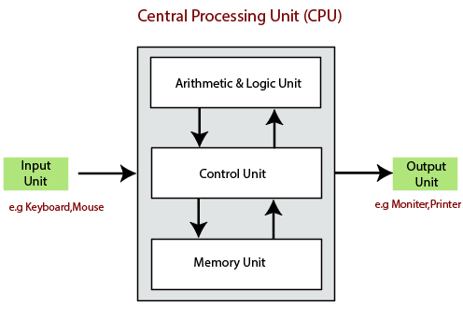
Basic block diagram of computer

Slide 12
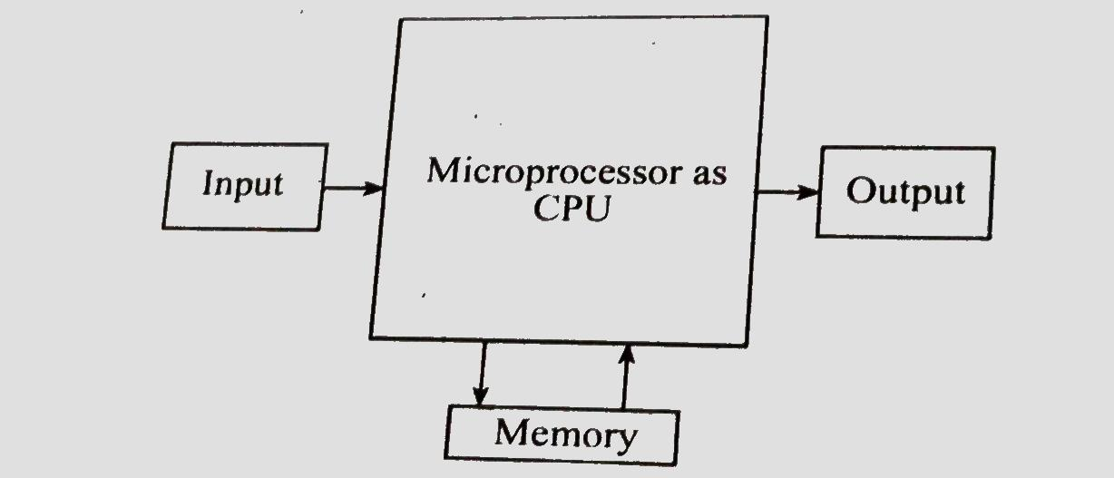
Microprocessor as CPU (MPU) Microcomputer-Computer using microprocessor as CPU

Slide 13
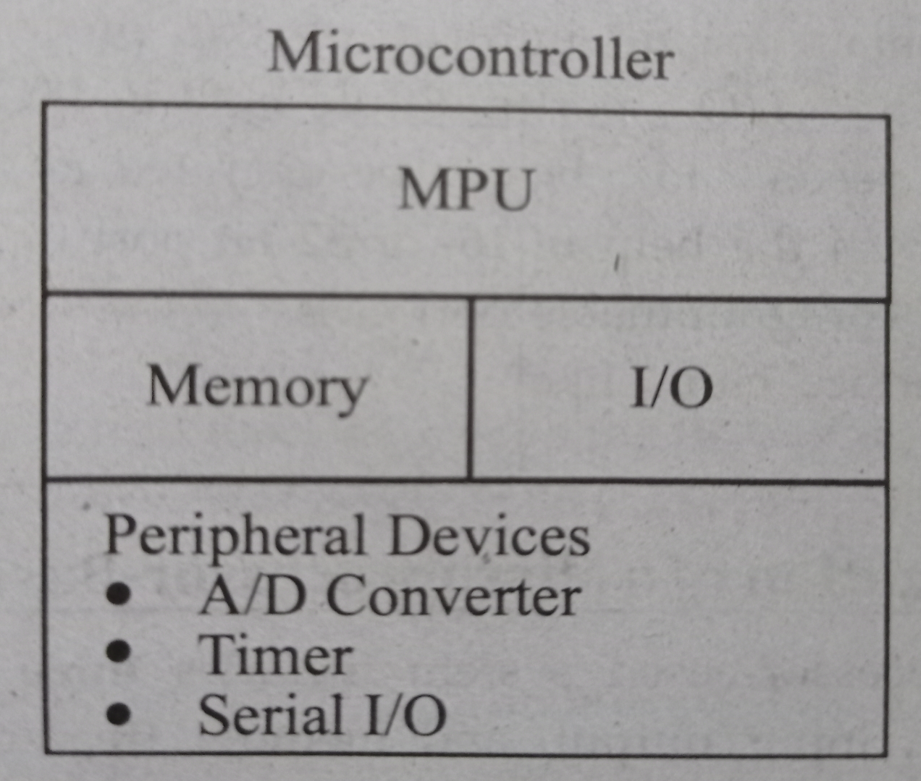
Microcontroller memory ,I /O interfacing circuits with MPU in a single chip

Slide 14
Historical Background
Development and enhancement of calculator lead to the development of computer.
Charles Babbage—Father of computer science—developed Difference Engine and Analytical Engine (Mechanical Computers)
Considered as base for modern digital computer.
Electronic era
Vacuum tubes(1st generation)
World’s first general purpose electronic digital computer—ENIAC(Electronic Numerical Integrator And Calculator) by John Mauchly and John Presper Eckret.

Slide 15
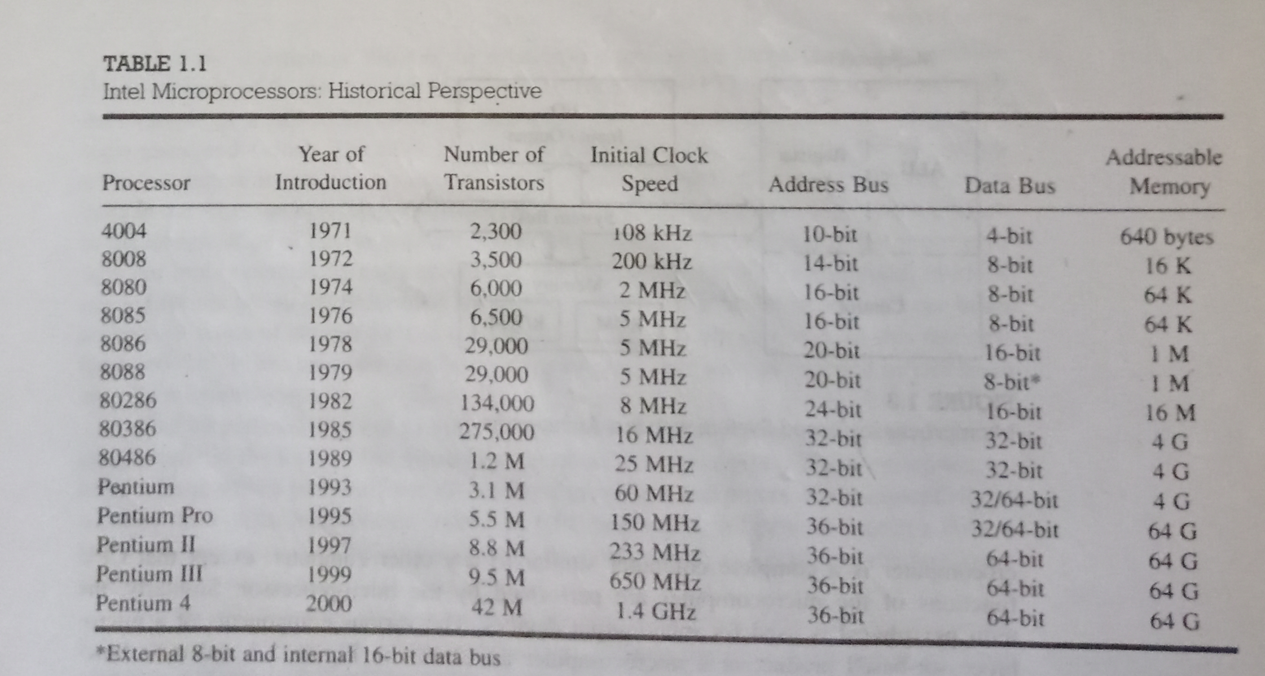
Evolution of Microprocessor

Slide 16
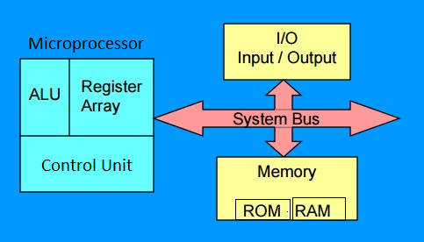
Microprocessor Based System
Fig: Microprocessor based system with Bus Architecture

Slide 17
Microprocessor (μp)
ALU(Arithmetic and Logic Unit):
Arithmetic operations: Addition ,subtraction , multiplication etc.
Logical operations : AND ,OR ,NOT etc.
Register Array:
Consists of registers such as B , C , D , E ,H , L.
Used to store temporarily during execution of a program
Accessible to users through instructions.
Control unit:
Controls the flow of data between microprocessor and memory and peripherals
Provides timing and control signals to all operations in microcomputers

Slide 18
Memory
Stores binary information as instructions and data and also provides those information to μp whenever necessary.
2 Types:
1. ROM(Read Only Memory):
Stores program that do not need alterations and can be read only.
2. RAM(Random Access Memory):
Also called Read/Write memory or User memory.
Information stored can be read and altered.

Slide 19
Input/Output(I/O)
Also known as peripherals
Communicates with outside world
Input devices: Keyboard ,mouse , switches etc.
Output devices : LEDs , CRT , Printer etc.
System Bus:
Communication path between μp and peripherals.
Group of wires to carry bits.
Consists of Data Bus , Address Bus and Control Bus.

Slide 20
Bus Organization
a channel through which bits are transmitted from source to destination
consist of set of common lines one for each bit register through which binary information is transferred one at a time.
control signals determine which register is selected by the bus during each register transfer
system bus consists of 50 to 100 separate lines, each line assign to a particular meaning of function.
can be categorized as: Data Bus , Address Bus, Control Bus

Slide 21
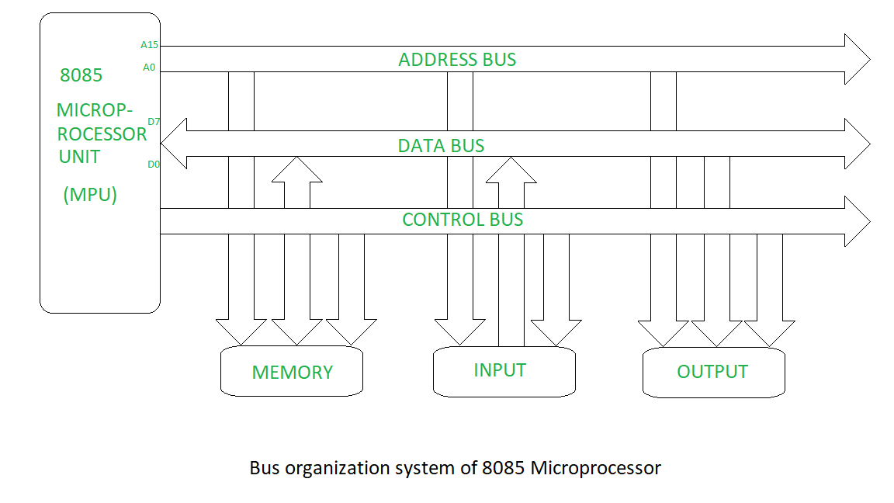
Data bus:
provides a path for moving data between system models.
consists of 8, 16, 32 etc. separate lines for the data transfer.
n bit data bus consists of n number of line

Slide 22
Address Bus:
used to designate the source and destination of data on the data bus.
the address bus maybe 8, 20,16,36 bit in size.
the size of the address bus determines the memory capacity of a processor if address bus is n-bit wide, then the memory capacity of the processor will be 2^{n}
bits.
Unidirectional flow ​ from MPU to peripheral devices.
3.Control bus:
used to control access the use of data and address lines.
transmit both command and timing signals.
specifies the operation to be performed.
task of control lines includes
memory read/ write
input /output R/W
Bus request / grant
interrupt etc.

Slide 23
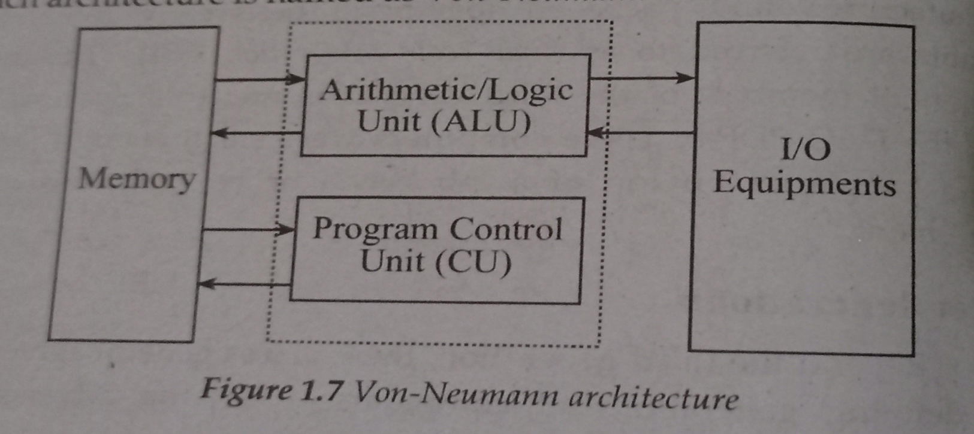
Architecture
1. Vonn Newmann Machine/Architecture
2. Harvard Architecture
1. Vonn Newmann Machine/Architecture

Slide 24
Contd:
Introduced by John Vonn Newmann in late 1940’s.
The main memory is used to store both data and instructions in binary format.
Also single bus called data bus or address bus is used for reading data and instructions from or writing to memory.
Instructions are fetched from memory one at a time.
the processor decodes and executes an instruction and the cycle continues until no more instructions are available.
Approach also called stored program concept.​
Fundamental basis for architecture of today’s digital computer.​

Slide 25
Storage locations of Control unit and ALU are called Registers.
Various registers of this model are:
1. MBR(Memory Buffer Register):
Consists of words to be stored in memory or is used to receive a word from memory.
2. MAR(Memory Address Register):
Contains address of word to be written into or read from MBR.
3. IR(Instruction Register):
Contains 8 bit opcode instruction being executed.
4. IBR(Instruction Buffer Register):
Used to temporarily hold the instruction from word in memory
5.PC(Program Counter):
Contains the address of next instruction to be fetched from memory.
6. Accumulator(A) and Multiplier Quotient(MQ):
Holds temporarily operand and results of ALU operations.

Slide 26
Assignment 1: 1. Differentiate between Microprocessor and Microcontroller. 2. Describe Harvard Architecture . What are differences between Harvard and Vonn Newmann Architecture?

Slide 27
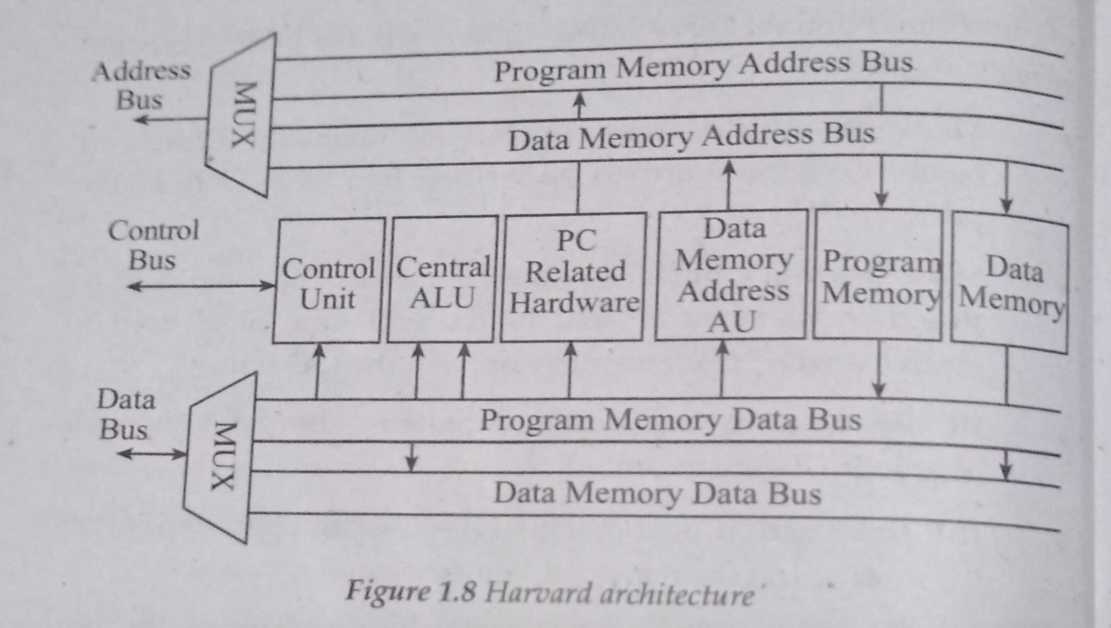
Harvard Architecture

Slide 28
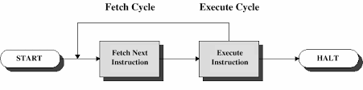
Processing cycle of a Stored Program Computer
Processor performs following things:
Fetch Instruction
Identify Instruction
Fetch Data
Process data
Write Back.

Slide 29
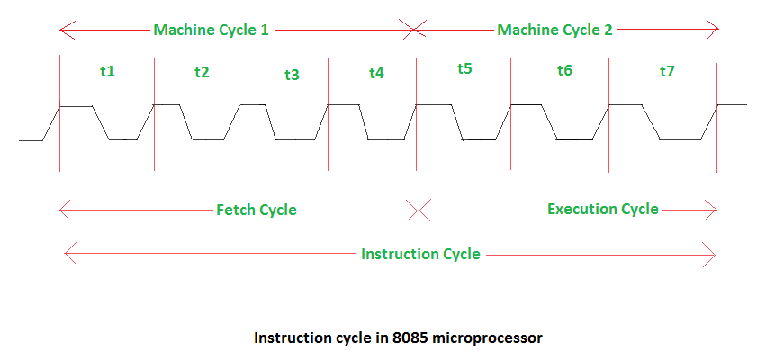
Instruction cycle

Slide 30
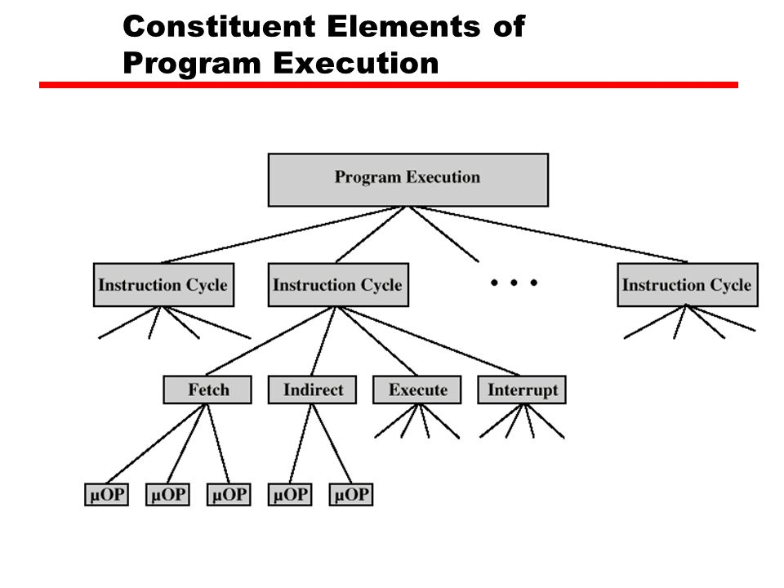
Micro-Operations
Computer executes program which consists sequence of instructions
Each instruction is made up of shorter sub cycles.
Performance of each cycle has number of shorter operations called micro-operations

Slide 31
Control Unit
Microprogrammed Control unit
Hardwired Control Unit
Uses flags, decoder common logic gates and other digital circuits.
on the basis of input signal output is generated.
difficult to design, test and implement.
inflexible to modify.
faster mode of operation, expensive and high error.
used in RISC processor .
uses sequence of micro instructions in micro programming language .
generates set of control signals on the basis of instruction.
easy to design test and implement.
flexible to modify.
slow mode of operation,
cheaper and less error.
6. used in CISC processor

Slide 32
Application of Microprocessor
Micro computer : Personal computers , laptops.
Embedded system : used in microcontrollers.
Measurement and testing equipment : in signal generators oscilloscopes, x-ray analyzer , frequency synthesizers, etc.
Scientific and engineering research
Industry: data monitoring system, automatic weighting system etc.
Security system: used in smart cameras, CCTV etc.
Automatic system
Robotics
Communication system
Game Machine
Accounting system
Military application system

Slide 33
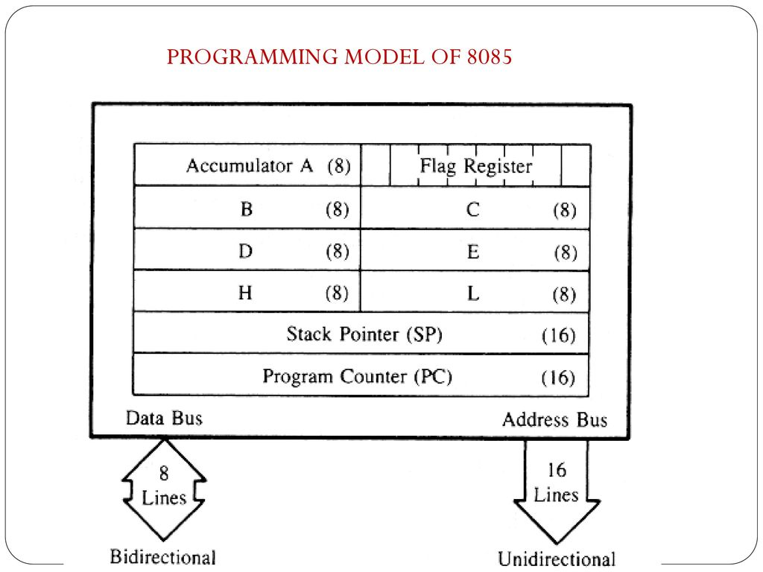
Programming Model of 8085 Microprocessor

Slide 34
Programming Model of 8085 Microprocessor (Contd)
1. Accumulator(A):
8- bit register.
Almost all arithmetic ,logical and I/O operations are performed on accumulator.
2. Registers(B,C,D,E,H,L):
six general purpose 8- bit registers.
Can be combined in pairs BC,DE,HL to perform 16-bit operations.

Slide 35
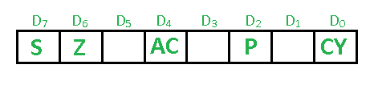
3. Flag Registers:
State of flags indicates the result of arithmetic and logical operations
Sign(S):
If MSB of result of last operation is 1(negative), then its status is 1(set) ; otherwise 0.
Zero(Z):
If the result of last operation is zero, then its status is 1(set) ; otherwise 0
Auxiliary Carry(AC):
If the last operation generates a carry from the lower half word (lower nibble), then its status is 1(set) ; otherwise 0.

Slide 36
Contd…
Parity(P):
If the result of last operation has even number of 1’s (even parity), then its status is 1(set) ; otherwise 0.
Carry(CY):
If the last operation generates a carry or borrow , then its status is 1(set) ; otherwise 0.
Ex: F3 H
+ 2F H
-----------------------

Slide 37
1111 0011 (F3 H)
+0010 1111 (2F H)
________________
10010 0010 (22H)
S-0 AC-1
Z-0 P-1 CY-1
Try:
C8 H + 34 H
3E H + BA H

Slide 38
4. Program Counter(PC):
16 bit register
Holds the address of next instruction to be executed.
5.Stack pointer(SP):
16 bit register
Points to a memory location in R/W memory called Stack.
Holds the address of top of Stack.

Slide 39
Register Transfer Language(RTL)
the symbolic notation used to describe micro operation transfer among the registers.
describes how the flow of instruction is carried out in between the registers during execution.
consists of two cycles: 1. Fetch cycle 2. Execute cycle
1. Fetch cycle:
a) PC contains address of next instruction to be executed . It is load it to MAR.
t1: MAR ← PC
b) the data of address location specified by MAR is loaded to MBR.
t2: MBR ← [MAR]
c) Transfer content of MBR to IR increase the PC.
t3: IR ←MBR
PC ←PC+1

Slide 40
2.Execute Cycle
a)Move the address of operand to MAR.
t1: MAR ←IR
b) Move the content of MAR to MBR.
T2: MBR ←[MAR]
c) Perform the desired computation and increase PC

Slide 41
RTL Examples
MOV Rd, Rs
t1: MAR ← PC
t2: MBR ← [MAR]
t3: IR ←MBR
PC ←PC+1
t4: Unspecified

Slide 42
MVI A,02H
Fetch Cycle:
t1 : MAR ← PC
t2: MBR ← [MAR]
t3: IR ←MBR
PC ←PC+1
t4: Unspecified
Execute Cycle:
t1 : MAR ←IR
t2 : MBR ←[MAR]
t3 : A ←MBR
PC ←PC+1

Slide 43
LXI B,050A H
Fetch Cycle:
t1 : MAR ← PC
t2: MBR ← [MAR]
t3: IR ←MBR
PC ←PC+1
t4: Unspecified
Execute Cycle 1: Execute Cycle 2:
t1 : MAR ←PC t1 : MAR ←PC
t3 : MBR ←[MAR] t2 : MBR ←[MAR]
t3 : C ←MBR t3 : B ←MBR
PC ←PC+1 PC ←PC+1

Slide 44
LDA 2050 H
Fetch Cycle:
t1 : MAR ← PC
t2: MBR ← [MAR]
t3: IR ←MBR
PC ←PC+1
t4: Unspecified
Execute Cycle 1: Execute Cycle 2: Execute Cycle 3:
t5 : MAR ←PC t8 : MAR ←PC t11 : MAR ←PC
t6 : MBR ←[MAR] t9 : MBR ←[MAR] 12 : MBR ←[MAR]
t7 : Z ←MBR t10 : W ←MBR t13 : A ←MBR
PC ←PC+1 PC ←PC+1 PC ←PC+1

Slide 45
STA 2050 H
Fetch Cycle:
t1 : MAR ← PC
t2: MBR ← [MAR]
t3: IR ←MBR
PC ←PC+1
t4: Unspecified
Execute Cycle 1: Execute Cycle 2: Execute Cycle 3:
t5 : MAR ←PC t8 : MAR ←PC t11 : MAR ←WZ
t6 : MBR ←[MAR] t9 : MBR ←[MAR] 12 : MBR ←A
t7 : Z ←MBR t10 : W ←MBR t13 : [MAR]←MBR
PC ←PC+1 PC ←PC+1 PC ←PC+1

Slide 46
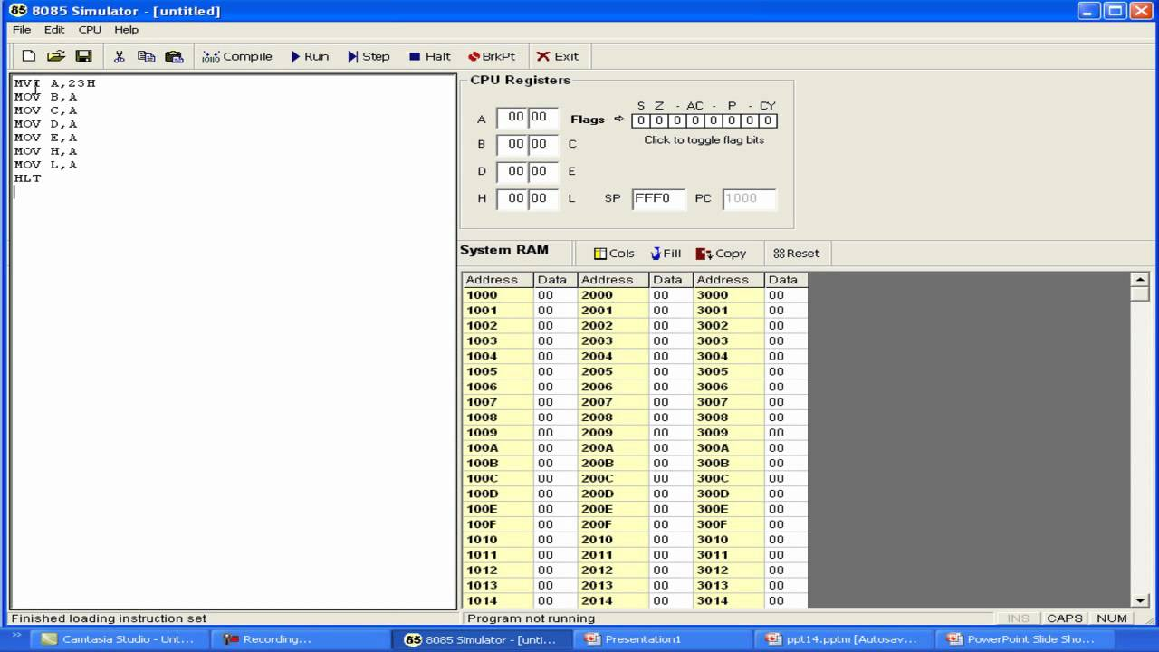
Screen shot of 8085 simulator

Slide 47
End of Chapter 1
Thank you!!

